Slide 1

Lime Electric Scooter
Team 6: Shiyi Hua, Akshay Kotha, Kexin Liu, Ziyuan Yan

Slide 2

Overview
Managerial Decision Problem: Increase usage of Lime Electric Scooter at UCSD
Meta Data
Demographic Information
General Insight with All Transportation Means
Insights from Students Who Have Used Before
Insights from Students Who Haven’t Used Before
Insights from Both Groups of Students
Recommendations

Slide 3
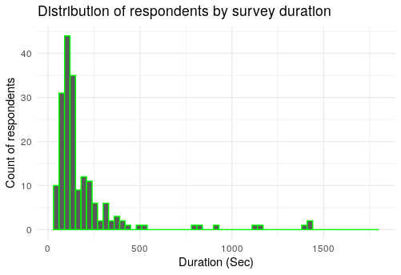
Meta Data
Summary & Distribution
Number of respondents = 195
Percentage of respondents who finished the survey = 91.3% (178)

Slide 4

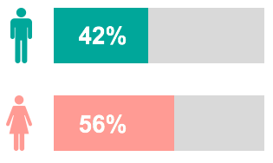
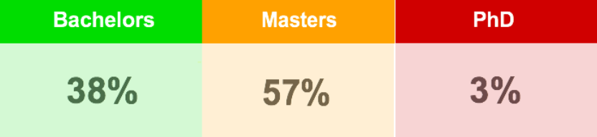
Demographic Information

Slide 5
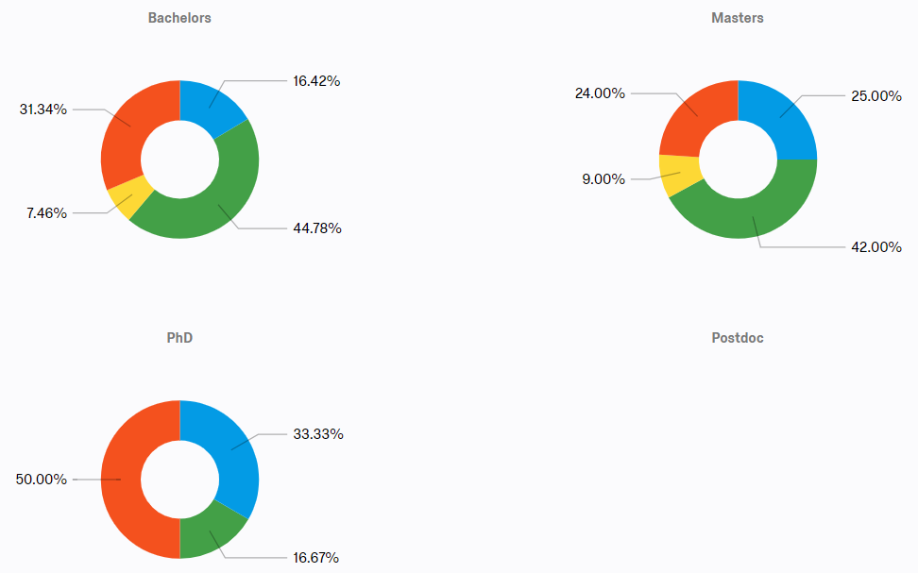
Most Important Factor of Transportation Means
(Bachelors, Masters) vs PhD

Slide 6
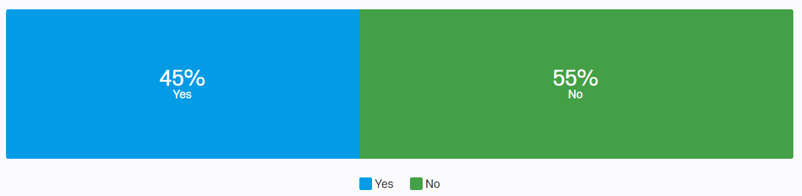
Students who have used

Slide 7
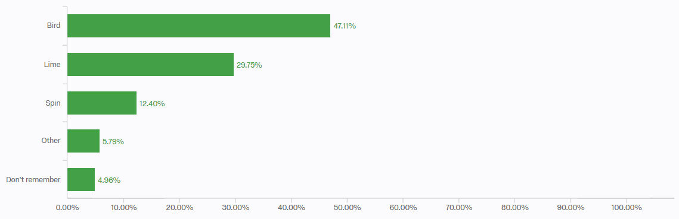
Brand Usage
Students who have used before
Other brands mentioned: Lyft, Uber, and Grin.

Slide 8
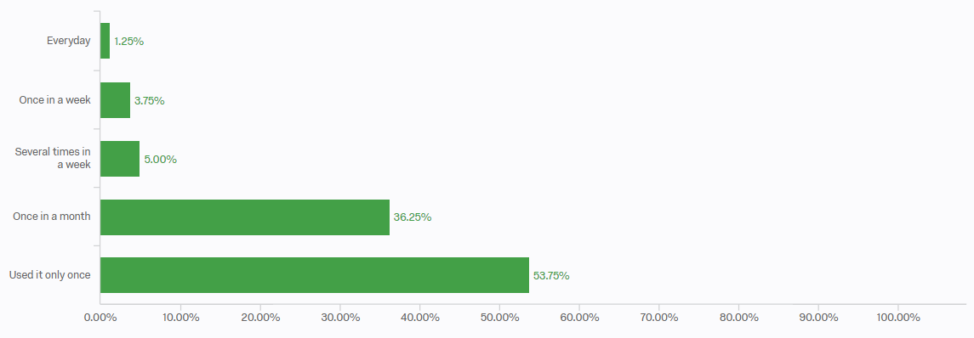
Frequency of Usage
Students who have used before

Slide 9
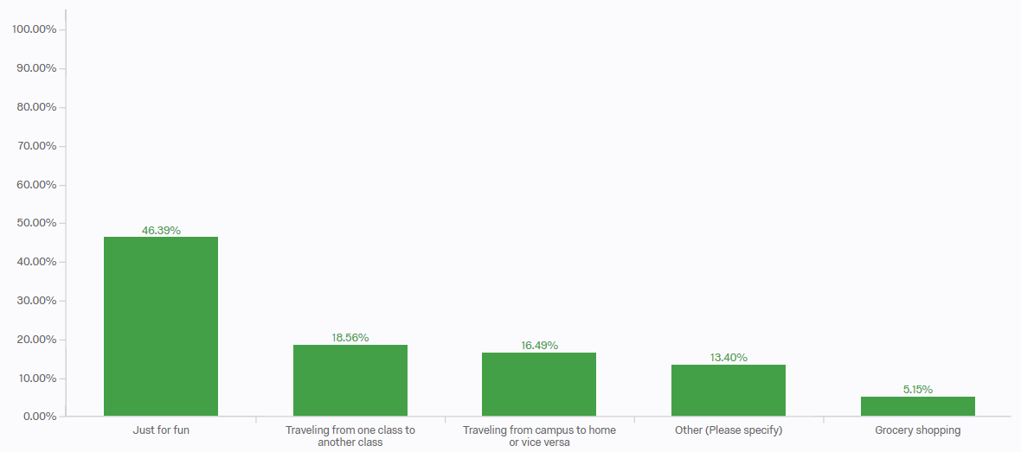
Purpose of Usage
Students who have used before

Slide 10
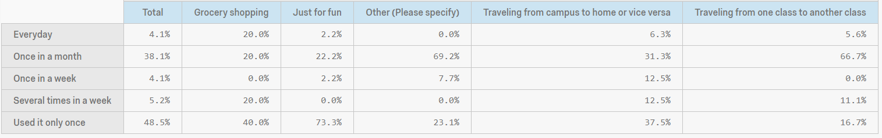
Crosstab of Purpose vs Frequency
Students who have used before
For people who used it just for fun, most of them used it only once.
For people who used it for travelling between classes, they tend to use it once in a month.

Slide 11
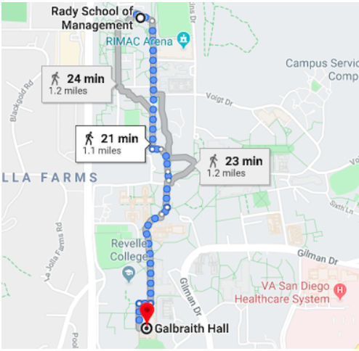
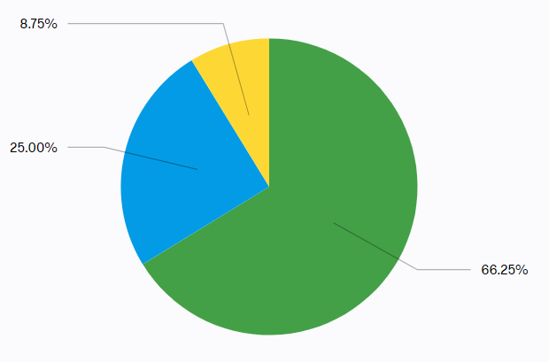
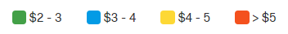
Highest Willingness to Pay

Slide 12
Students who haven’t used

Slide 13
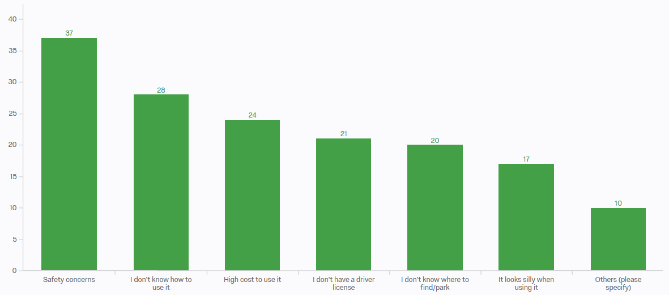
Reasons for Not Using
Students who haven’t used before

Slide 14
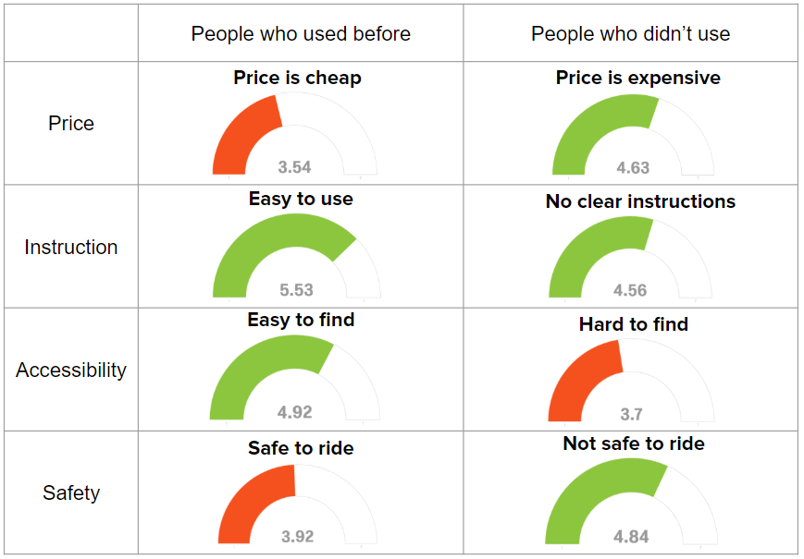
Comparison of Opinions for Four Features
Used vs Unused

Slide 15
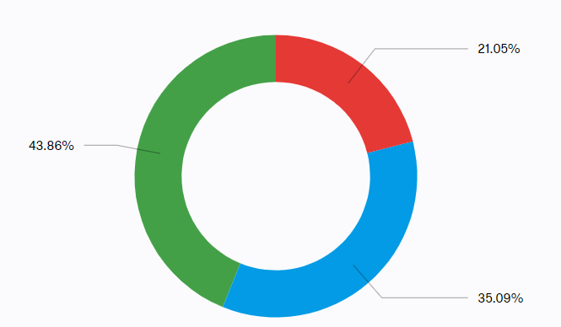
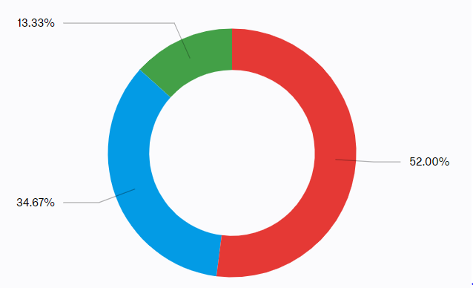
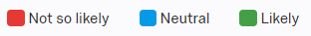
Comparison of Willingness to Try in the Future
Used vs Unused
People who used before
People who didn’t used before

Slide 16
Both

Slide 17
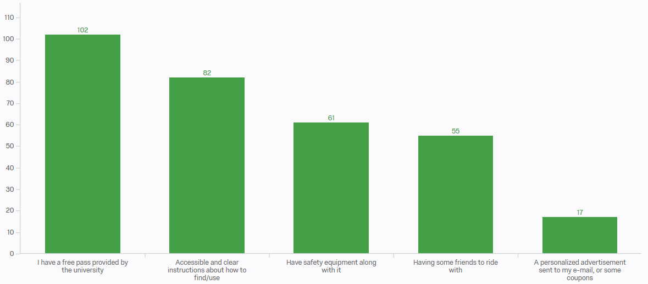
Factors Encouraging Students to Ride
Statistical Analysis
Statistical reasoning

Slide 18
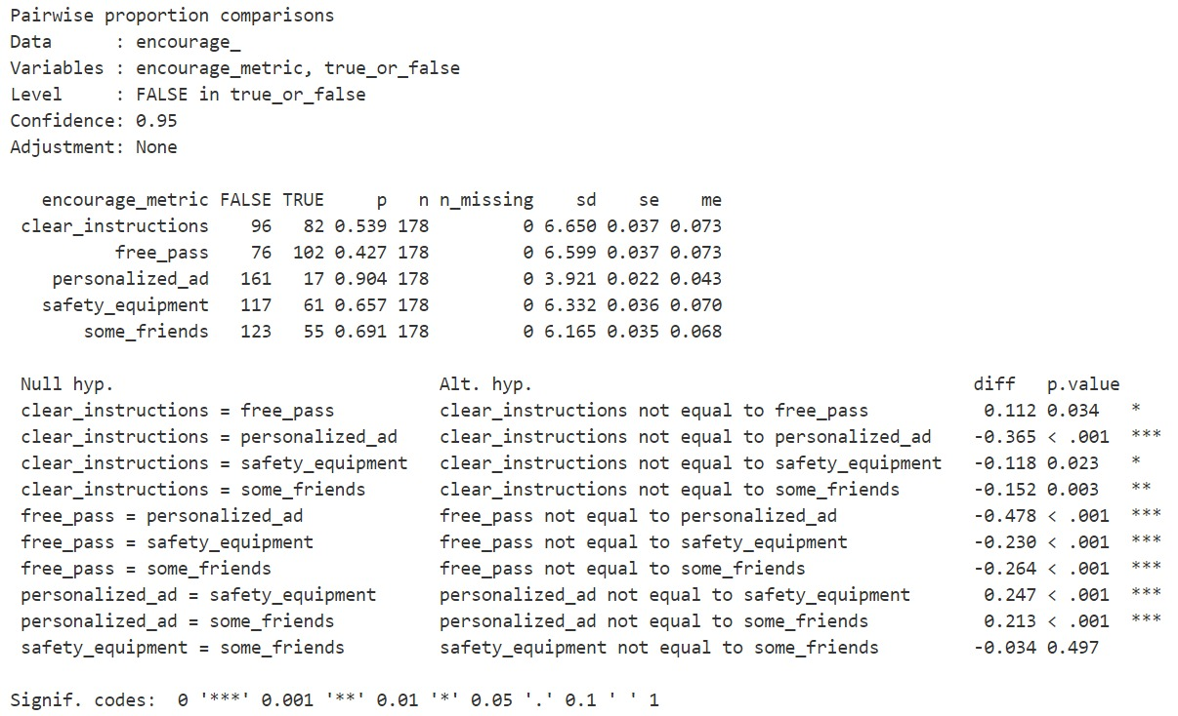

Slide 19
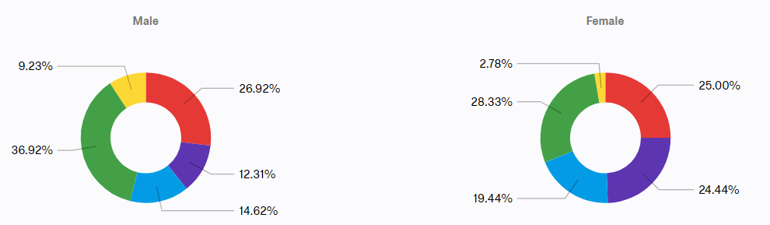
Factors Encouraging Students to Ride
Male vs Female

Slide 20
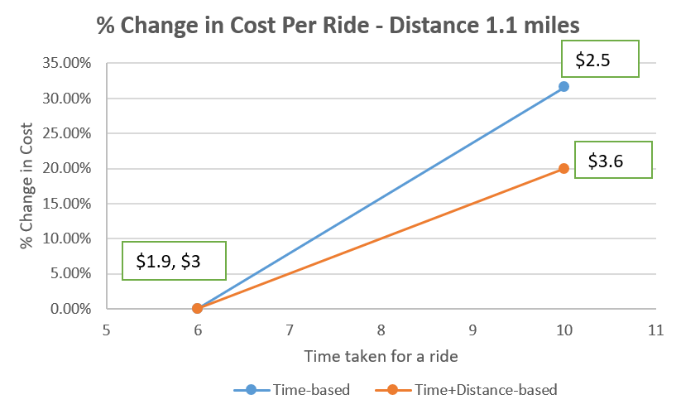
Recommendation 1
Change Pricing Strategy
Net cost for user = Base fare + (Cost per minute * time in ride) + (Cost per mile * ride distance)
- More reasonable and safer
Notes:
Current price in San Diego: $1 to unlock + $0.36/1 min
The percentage increase in cost per ride is higher for Time-based pricing and hence Lime should consider changing the pricing to a Time+Distance-based calculation. This in turn will make sure they are charging users similarly (magnitude of price) and yet allowing them to take some extra time to complete their ride without haste and injure themselves.

Slide 21
Recommendation 2
Provide Safety Equipment
Provide helmet for each scooter in UCSD.
Require that the ride ends only if helmet is properly returned. Otherwise, users will be charged more based on the pricing policy.

Slide 22
Recommendation 3
Implement Promotion Strategy
First trial is free.
Establish partnership with UCSD.
- MTS: buy quarterly pass to ride scooters.
- Lyft: get $ cash back for each 10 rides, $60 Lyft FLEX
Shared Credit Package = $50 (20% bonus)
Offer discount for pair riding and/or referring.

Slide 23
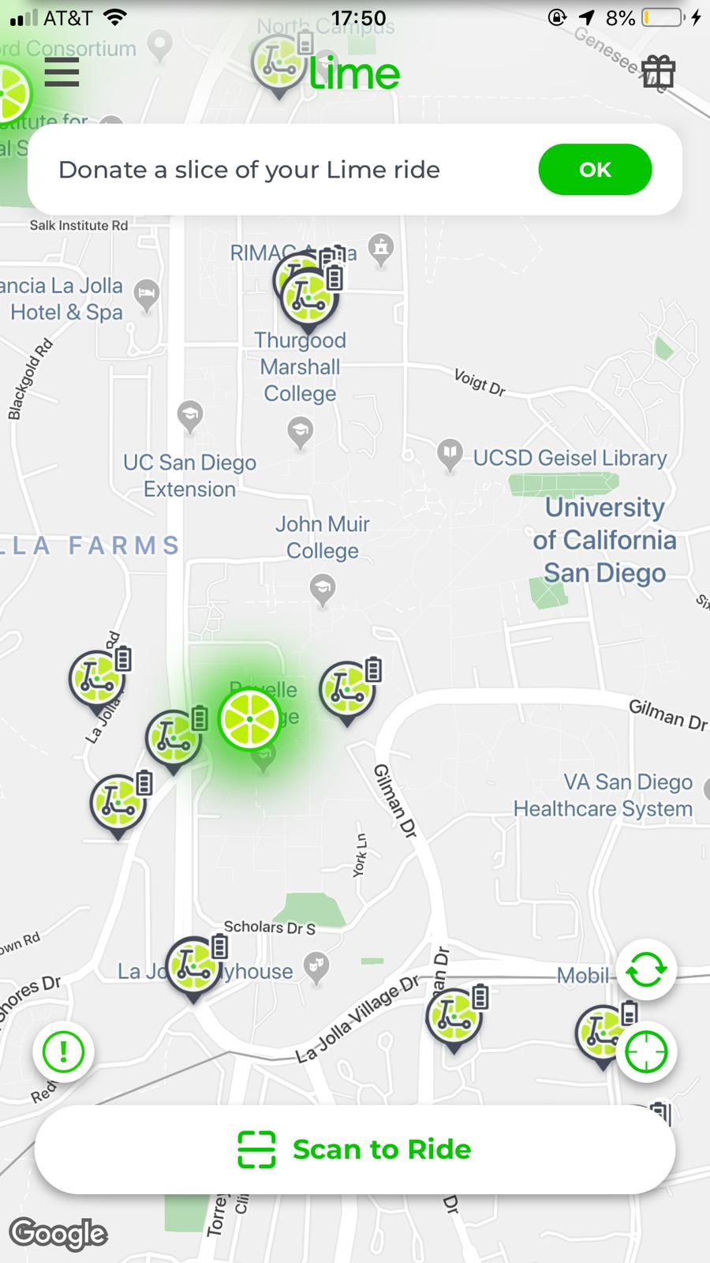
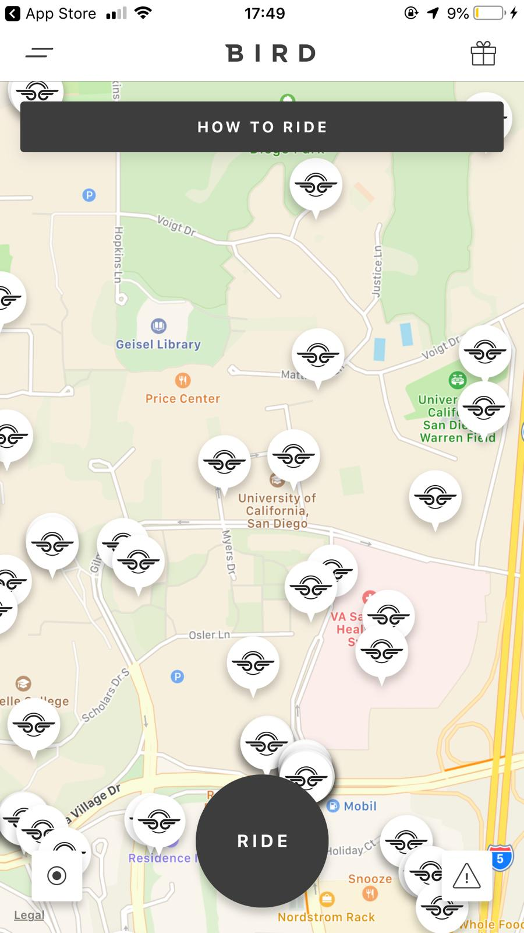
Recommendation 4
Provide Instructions
Construct easy-to-find instructions with vivid visualizations on mobile APP.
Distribute flyers with these instructions at the beginning of each quarter.

Slide 24
Thank you!

